Slide 1
Faculty Schedule Redesign Project
University of Ljubljana, Faculty of Computer and Information Science
Team: Nik Čadež, Nik Jukič, Gašper Kolbezen

Slide 2
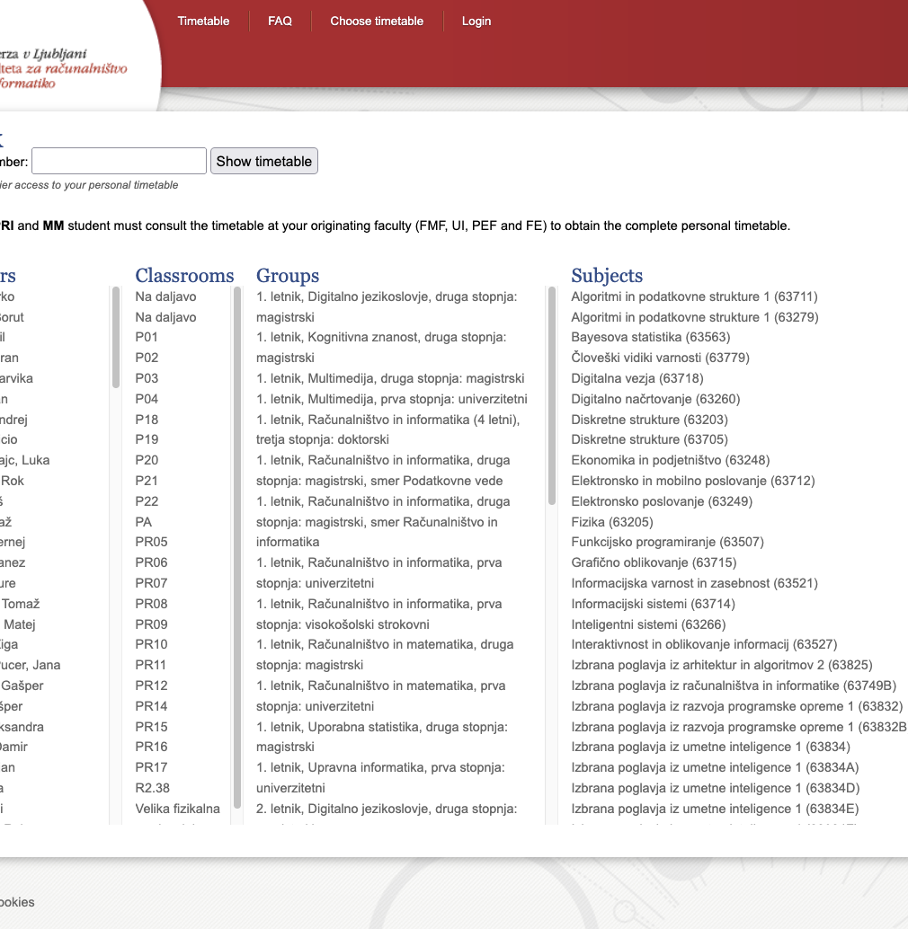
Current schedule system limitations:
Poor mobile experience
Limited functionality
Poor usability
Project goals
Create user-friendly, mobile-optimized schedule system

Slide 3
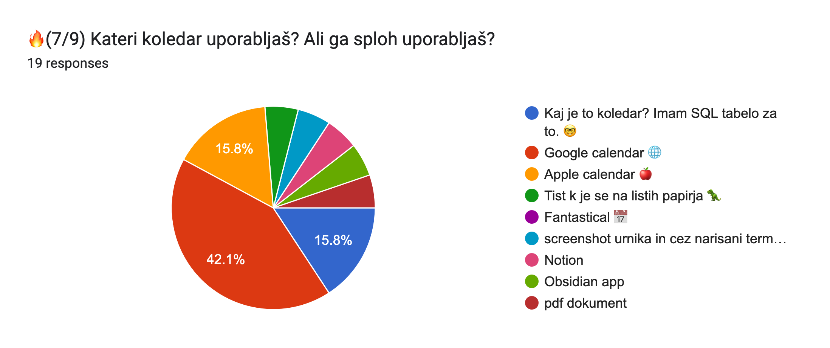
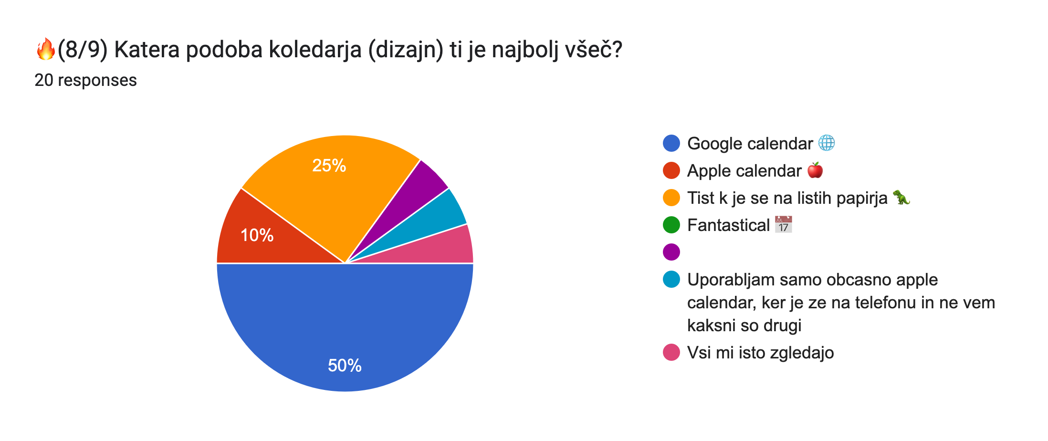
Research
User-centered design approach
Brainstorming session
Initial survey with 20 students
Key findings
80% prefer Google Calendar
Need for better mobile experience
Desire for schedule customization

Slide 4
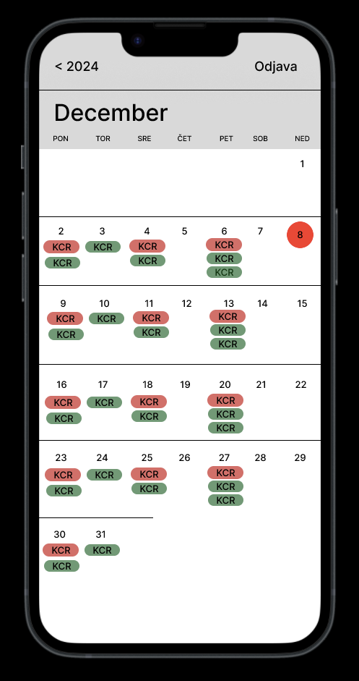
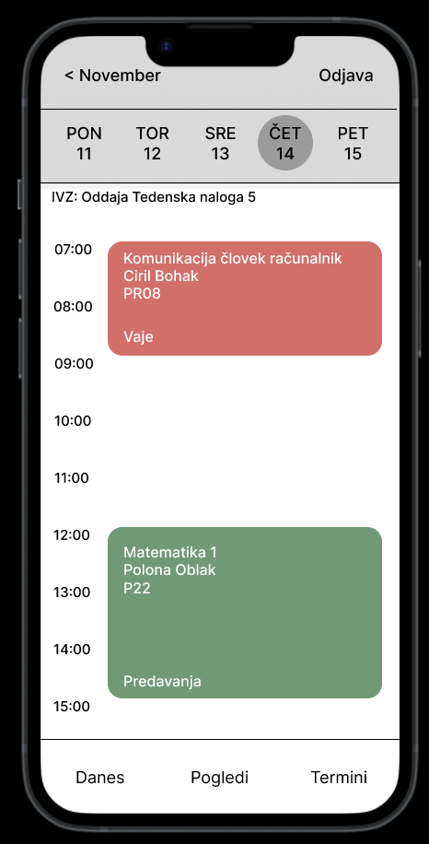
Design Principles
Key principles identified:
Organization (daily/weekly/monthly views)
• Visual coherence (color coding)
• Intuitive interface
• Enhanced navigation
• Customization options

Slide 5
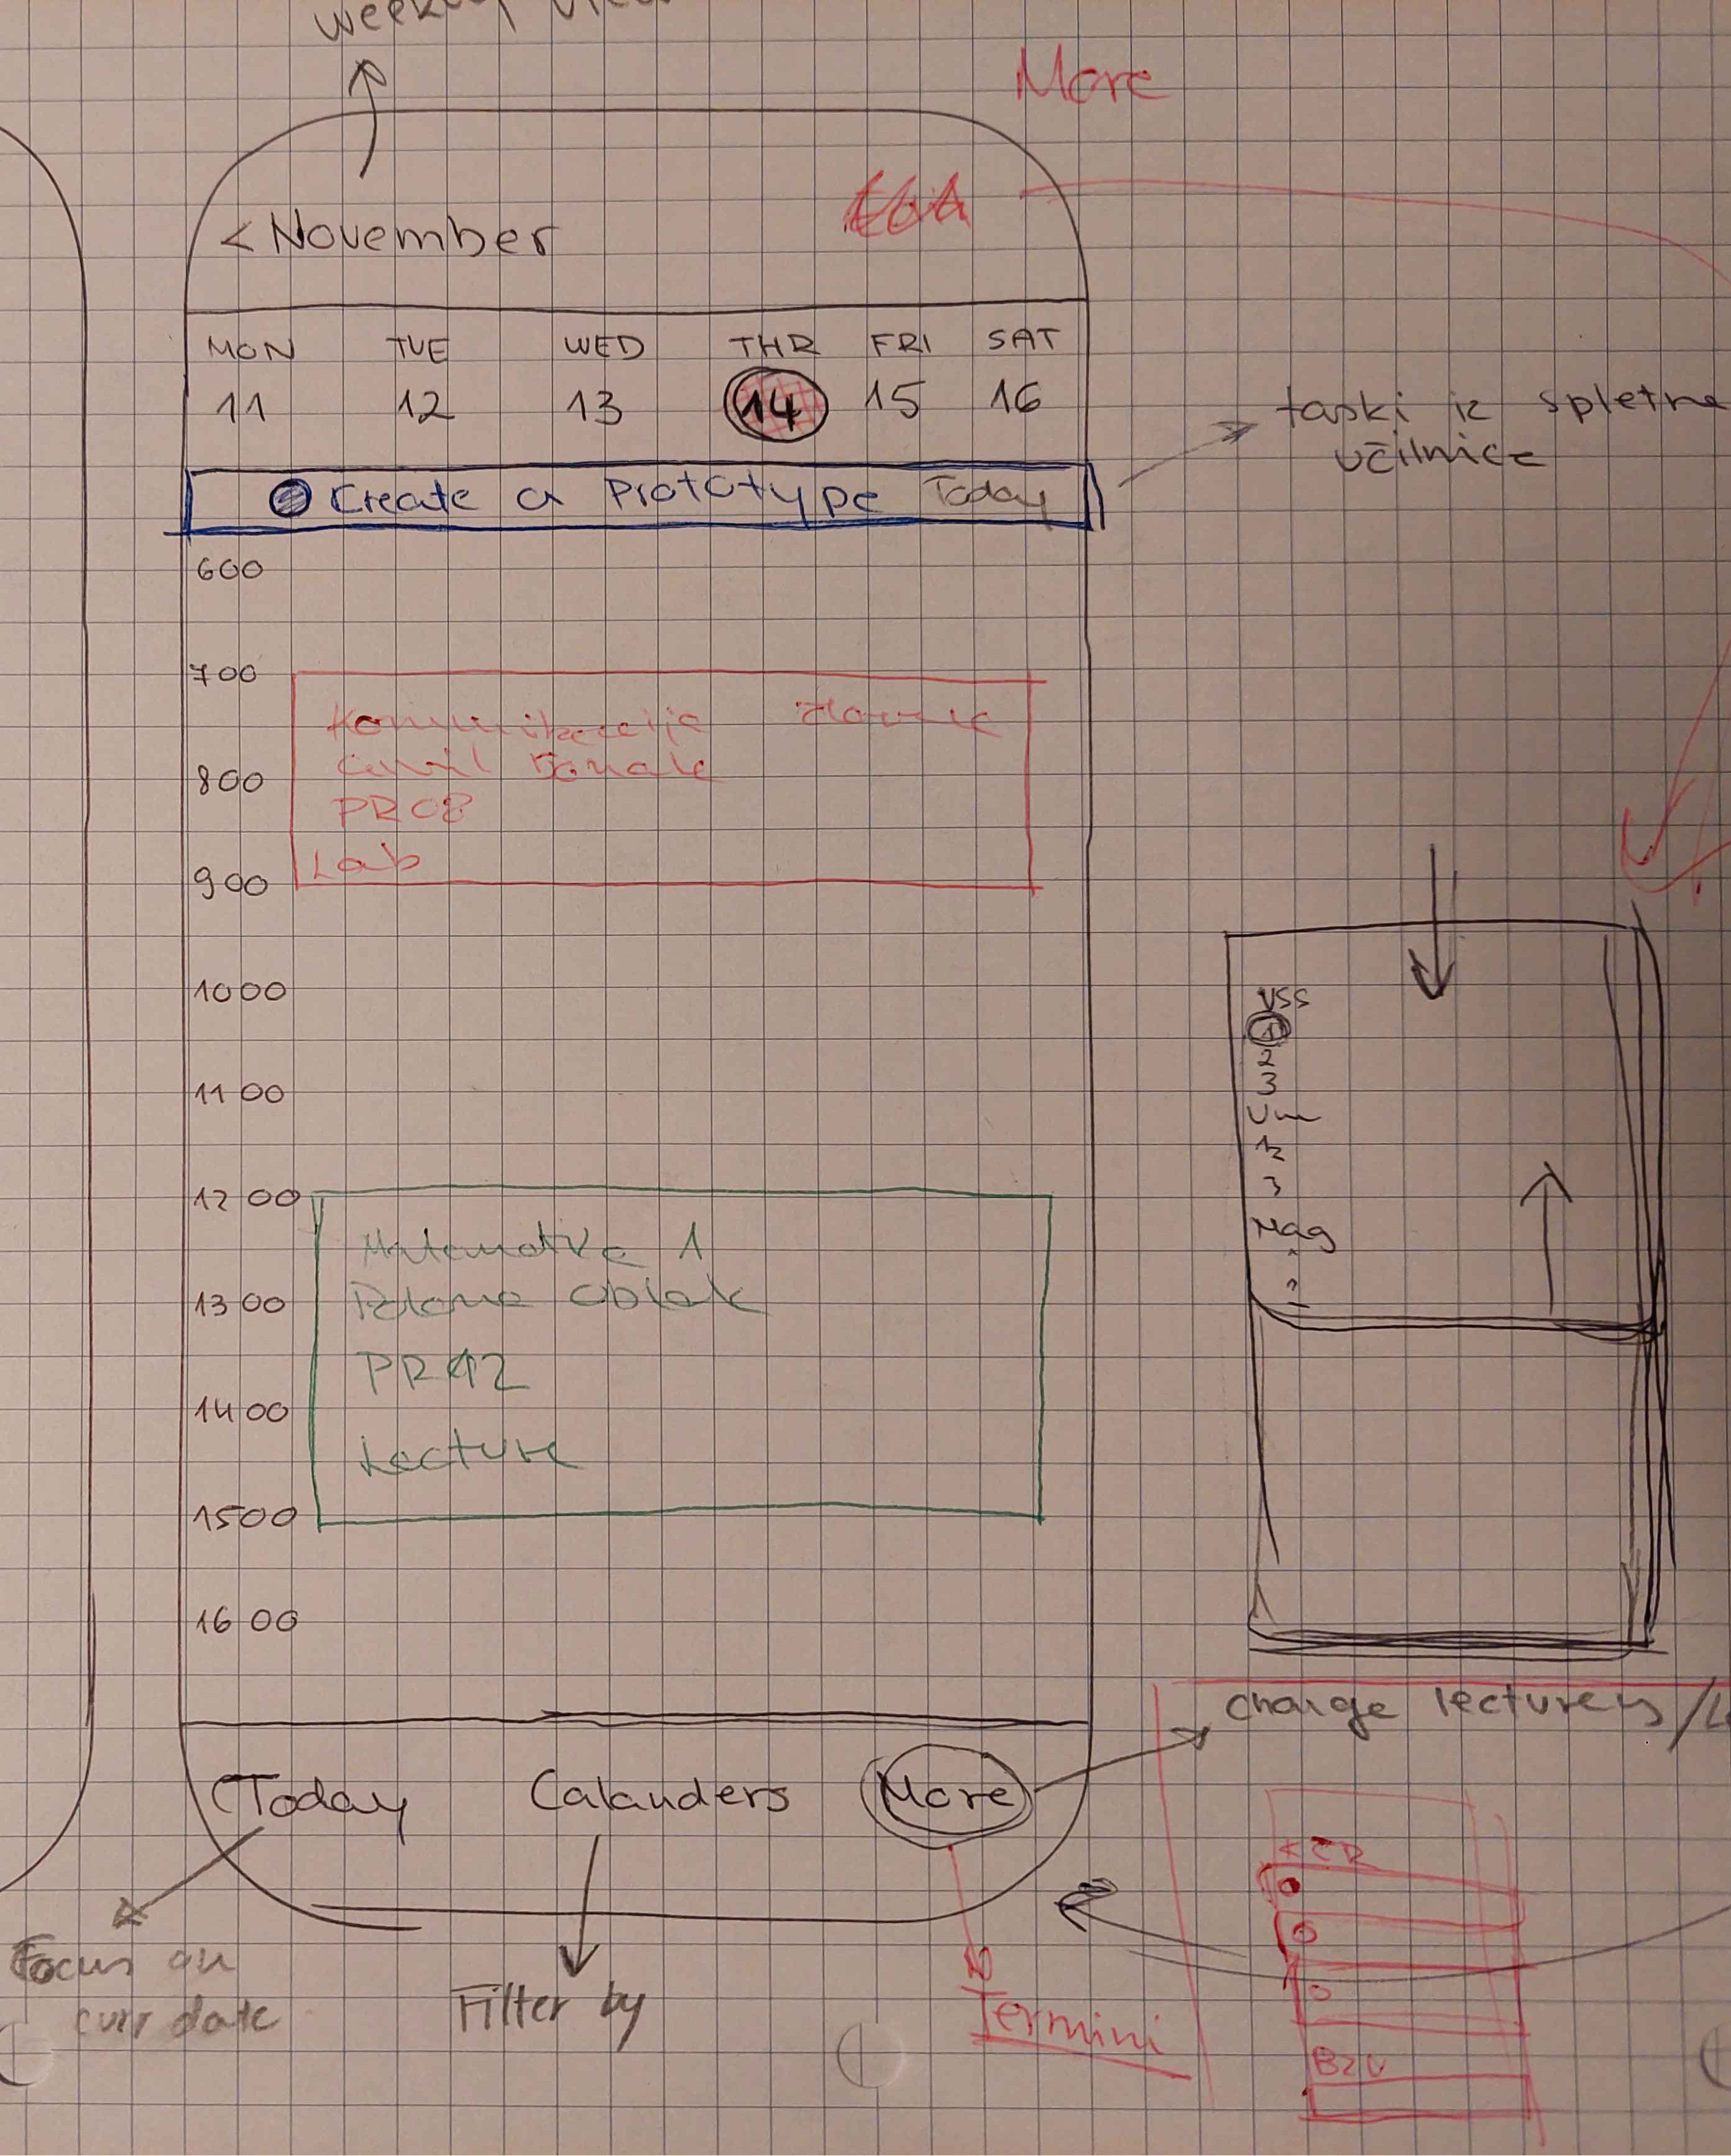
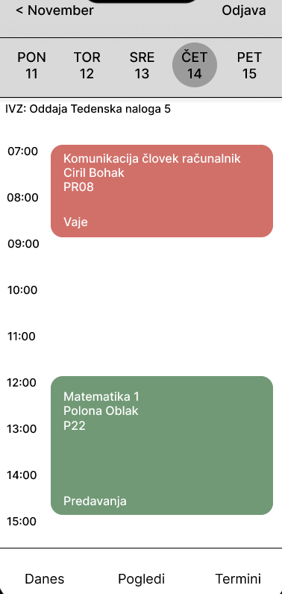
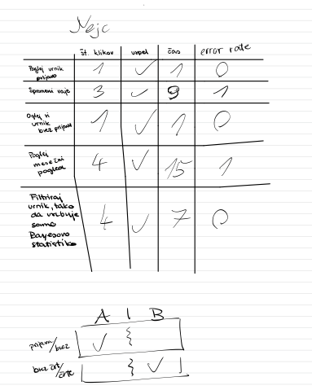
Development Process
• Low-fidelity prototypes
• Multiple iterations based on feedback
• High-fidelity Figma prototype
• Usability testing with real users
• A/B testing for interface elements

Slide 6
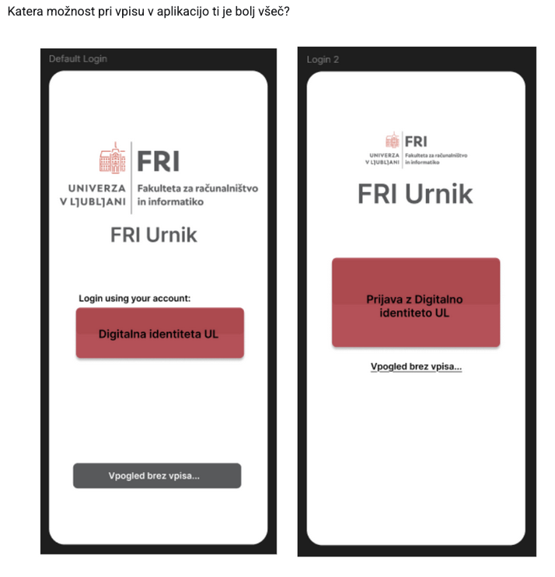
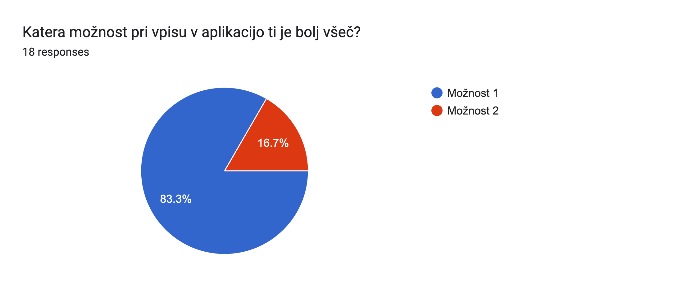
Second iteration
Brainstorming
A/B testing survey
Implemented winning designs
Accessibility features for color blindness

Slide 7
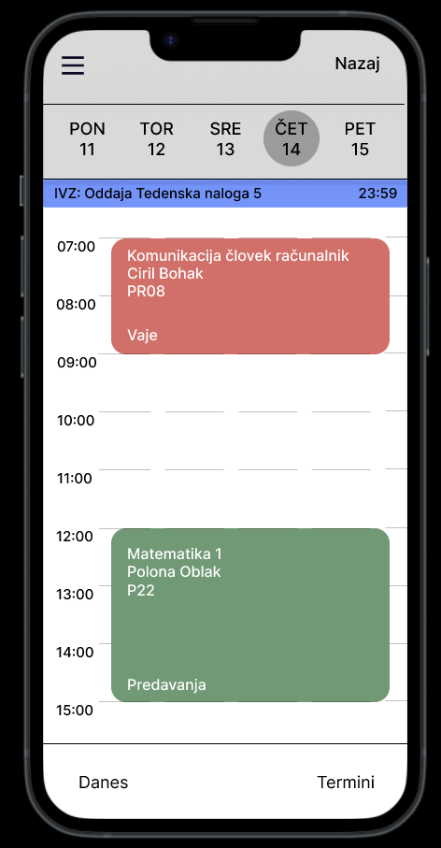
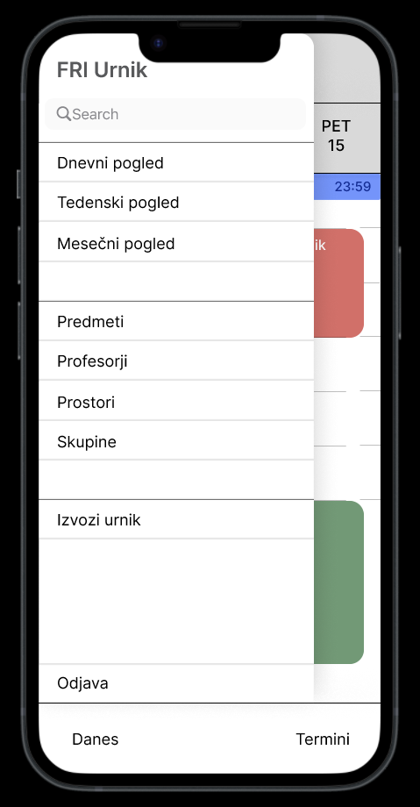
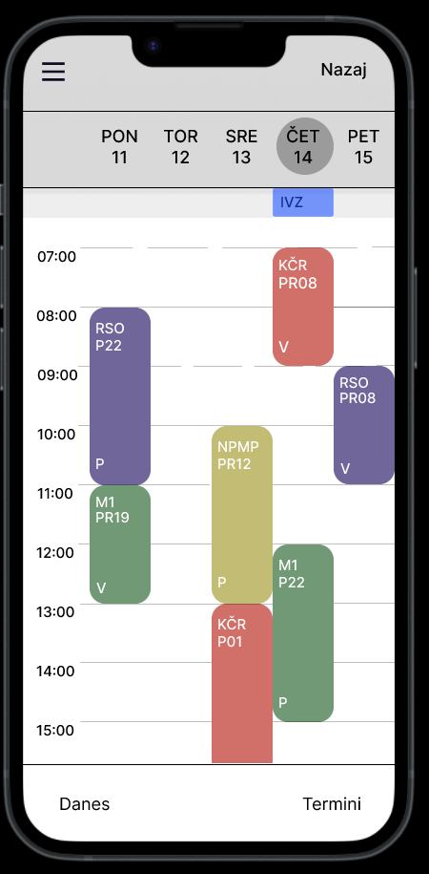
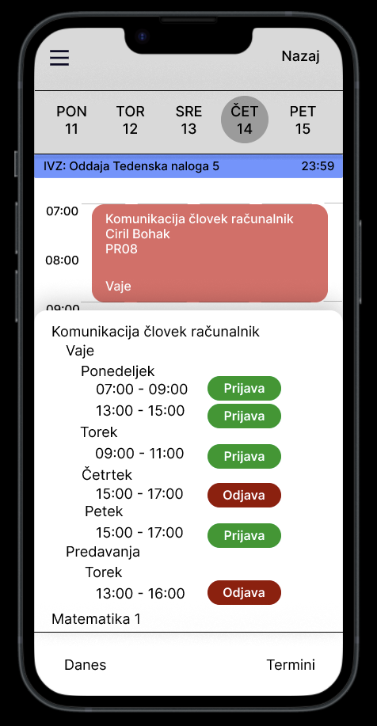
Final Solution Features
Intuitive sidebar navigation
Comprehensive search functionality
Schedule customization
Online classroom integration
Mobile friendly design!

Slide 8
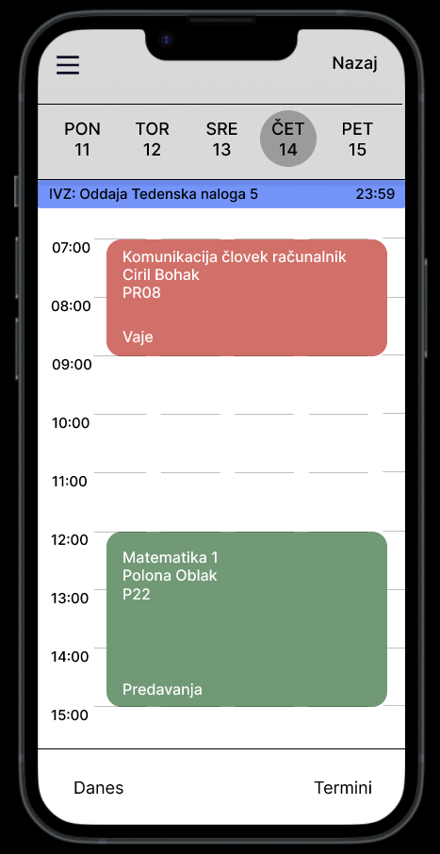
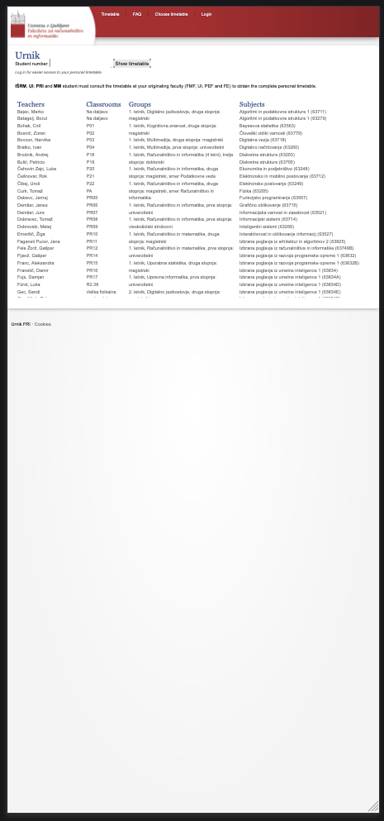
Results & Impact
Successfully addressed initial objectives
Improved mobile usability
Enhanced user experience
Ready for future implementation
Positive user feedback

Slide 9
Thank you!

Slide 10
Questions?

